Slide 1
ALLSTATE POLICY PREDICTION
Gagandeep Singh
Janhvi Parekh
Srishti Govil

Slide 2
Objective :
Predict the purchased coverage options for customers using transaction history

Slide 3

Overview
When a customer shops an insurance policy, they receive a number of quotes with different coverage options.
To predict the eventual policy option a customer will buy.
If the eventual purchase can be predicted sooner, the quoting process is shortened and the issuer is less likely to lose the customer's business.
Notes:
Policy details viewed by each customer.
Customer’s personal information.

Slide 4





Technologies Used
Databricks- pyspark
AWS
RStudio
Jupyter notebook
Caspio - HTML, CSS
Notes:
Can do similarly on data stored in HDFS

Slide 5
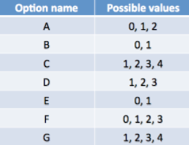
Data Overview
Train Data: 665250 Rows, 24 Columns
Test Data: 198856 Rows, 24 Columns
Data Source: Kaggle
https://www.kaggle.com/c/allstate-purchase-prediction-challenge
Sample Data:
customer_ID - A unique identifier for the customer
car_value - How valuable was the customer’s car when new
risk_factor - An ordinal assessment of how risky the customer is (1, 2, 3, 4)
age_oldest - Age of the oldest person in customer's group
A,B,C,D,E,F,G - the coverage options
cost - cost of the quoted coverage options
Policy Options:

Slide 6
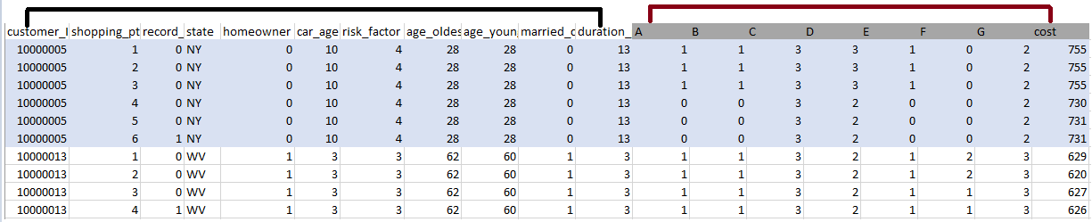
Data Overview
Customer’s transaction history
Customer’s personal information
Train data:
Policies viewed by each customer
Policies ultimately purchased by each customer
Test data:
Policies viewed by each customer
GOAL:
Coverage option each customer will buy and price to be quoted
Given Predictors
Response Variables
Notes:
Earlier quoted prices and policies

Slide 7
Data Preprocessing
Removing Null Values:
C_previous: NA values replaced by 0
Duration_previous: NA values replaced by 0
Car_value: NA values replaced by mode of all car values
Risk_factor: Multinomial Regression in R to predict NA values.
Customer transaction history integration:
1 Row per customer
Policy versions added as new attributes(A_0, A_1, A_2): Number of Interactions
String to Numerical transformations: CarValue
Notes:
Data exploration and preprocessing
C_previous - What the customer formerly had or currently has for product option C (0=nothing, 1, 2, 3,4)

Slide 8
Building Prediction Models
Predicting policy versions
Decision Trees
Random Forest
Gradient Boosting
Predicting cost
Linear regression
Notes:
The above models were used to predict the versions of policies [ A - G ] bought by the customer.
Gradient boosting supports only binary classification

Slide 9
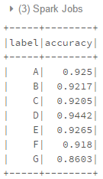
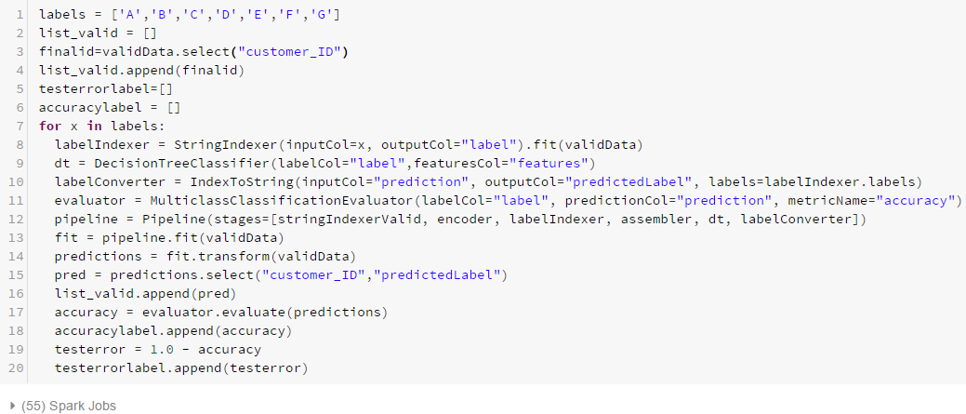
Decision Trees
Simple to understand and to interpret
Able to handle multi-output problems
Requires little data preparation.

Slide 10
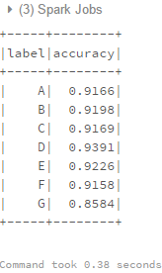
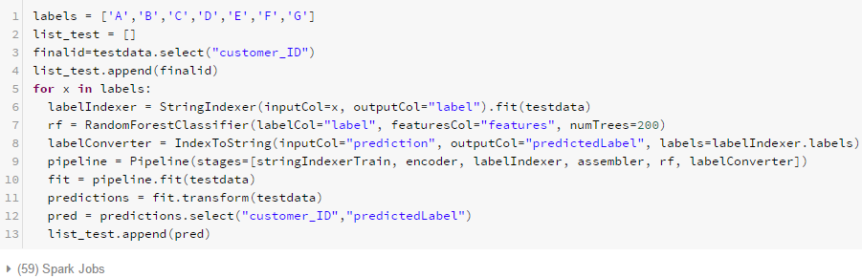
Random Forest
Provides high accuracy
Ensures no overfitting
De-correlates trees

Slide 11
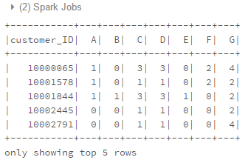
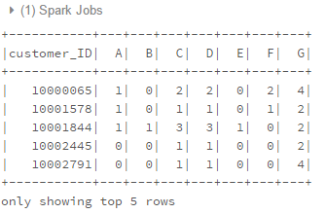
Test Data Prediction
Random Forest
Decision Tree

Slide 12
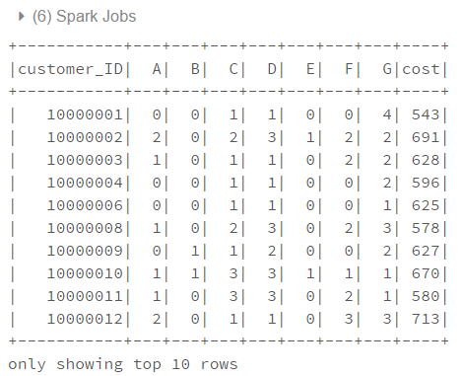
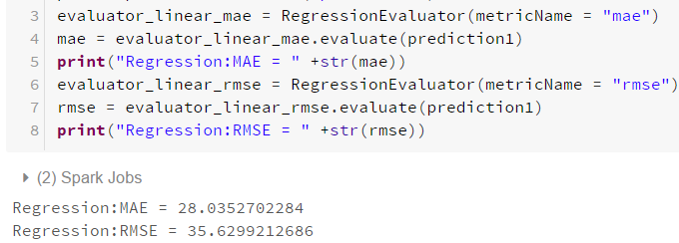
Linear Regression to Predict Cost

Slide 13
DEMO

Slide 14
Conclusion
Early offering of correct policy combination leads to stronger customer relationships and prevent losses.
In future, built model can be used to improve pricing accuracy and offering customized quotation.
Big data and analytics can be used to find similarity between customers. Similar customers can then be offered similar policies.
Notes:
Through Big Data & Analytics, insurers are driven to improve their pricing accuracy, create customized products, Accurate predictions lead to stronger customer relationships and prevent losses. Predictions can be used to find similarity between customers. Similar customers can then be offered similar policies.

Slide 15
THANK YOU !
QUESTIONS ?

